Slide 1
Foundation of computer science
By : Mohamed Agami

Slide 2

Lecture12
RAM part 1

Slide 3
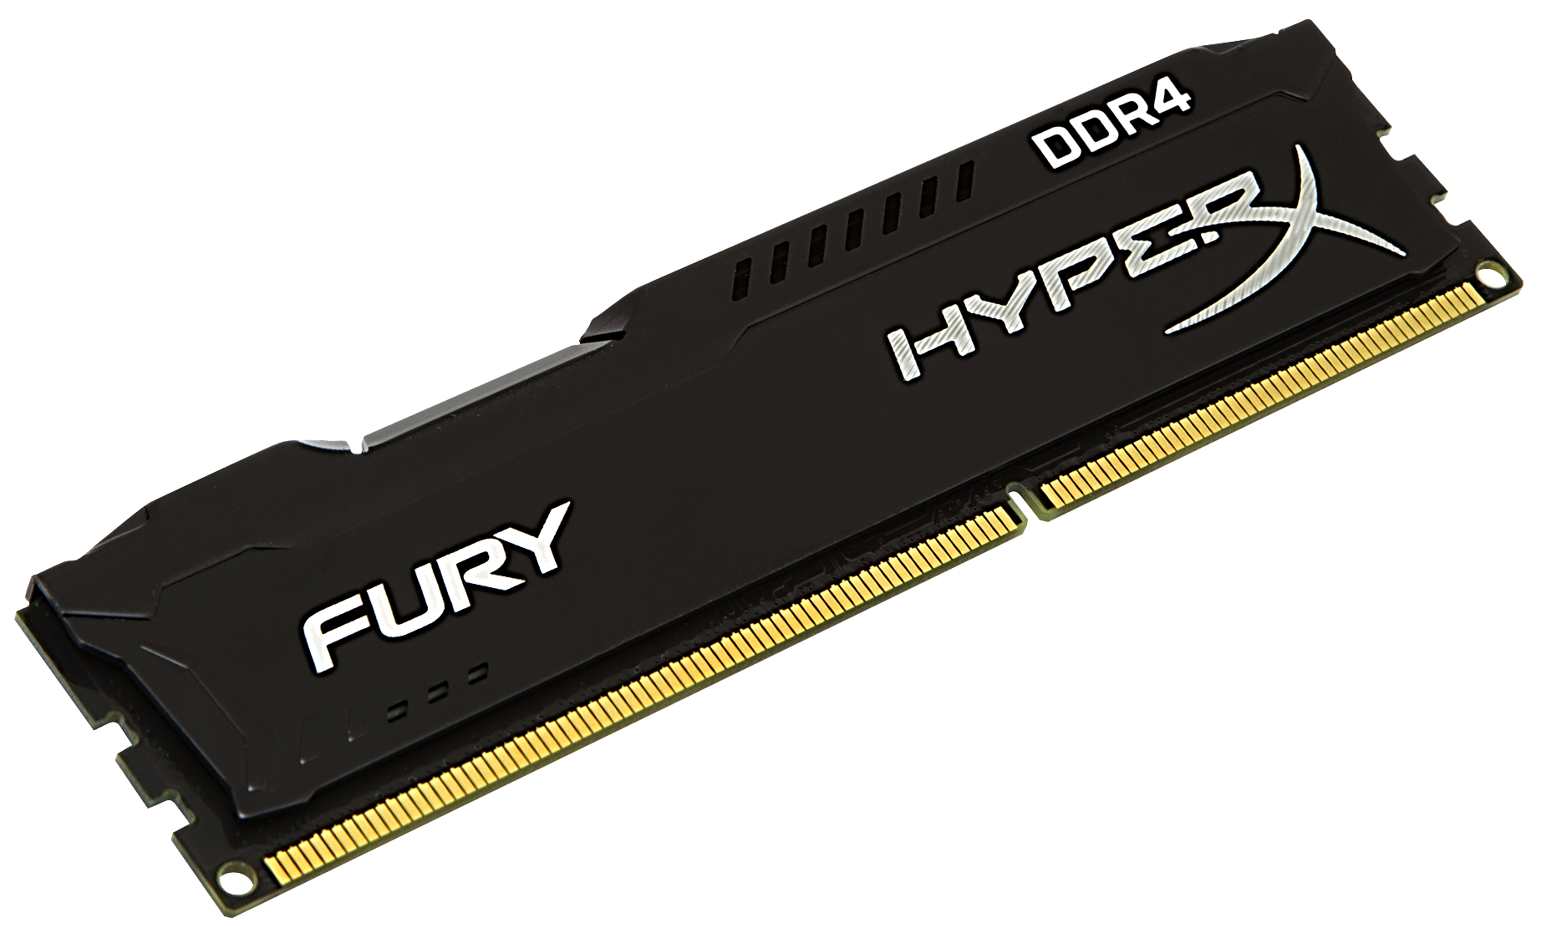
RAM (Random access memory)

Slide 4
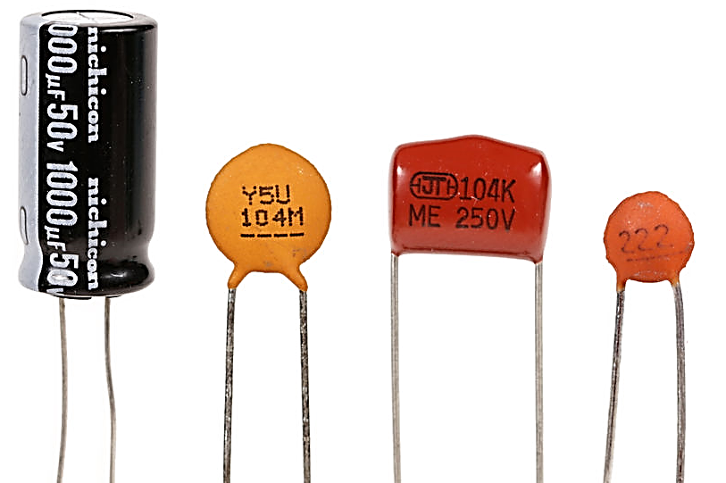
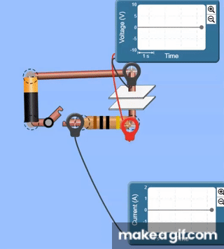
Capacitor

Slide 5
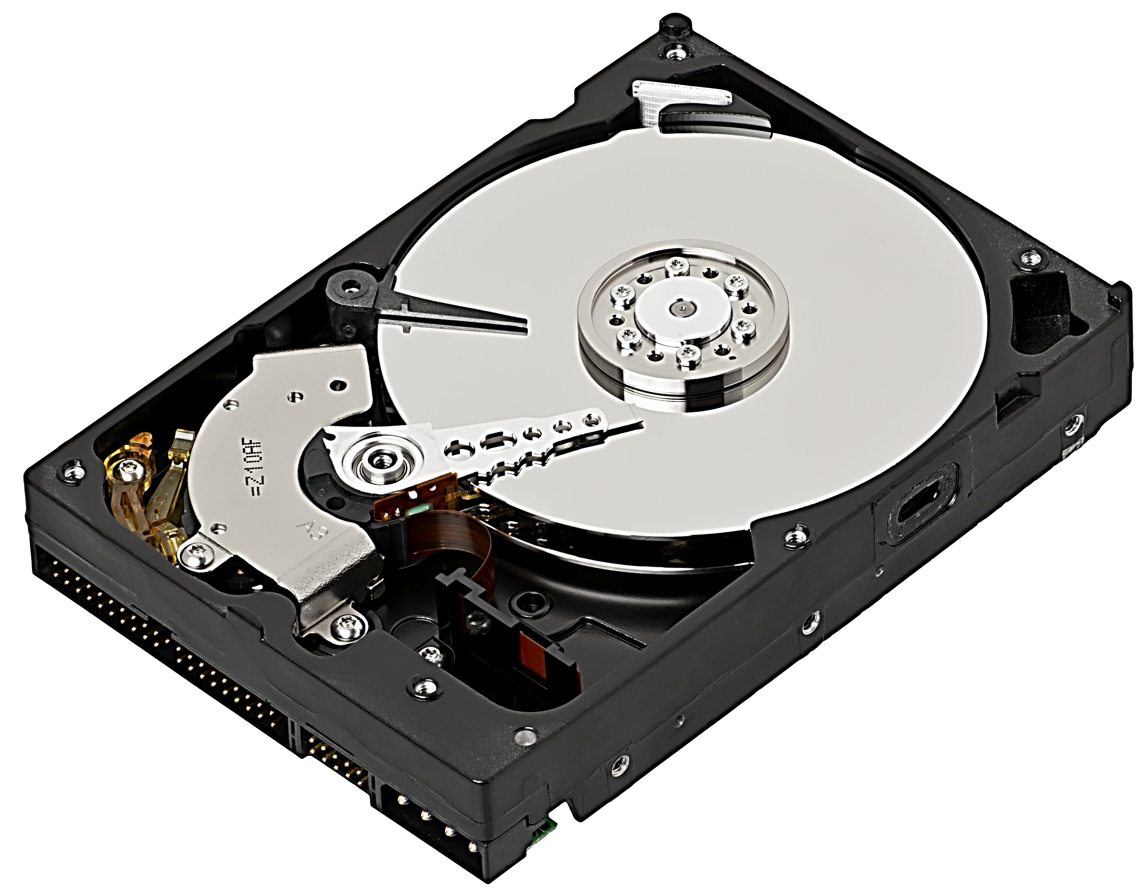
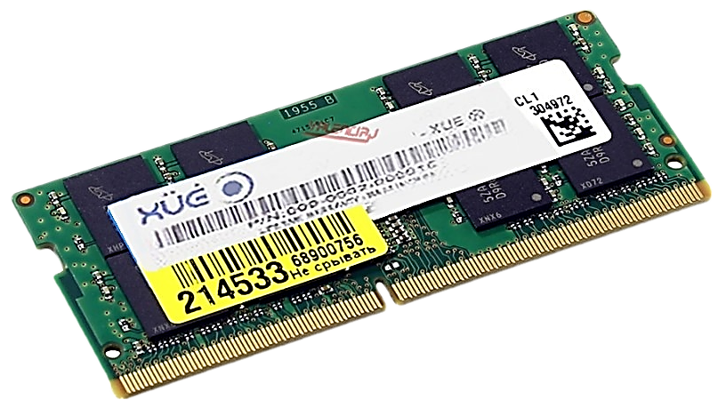
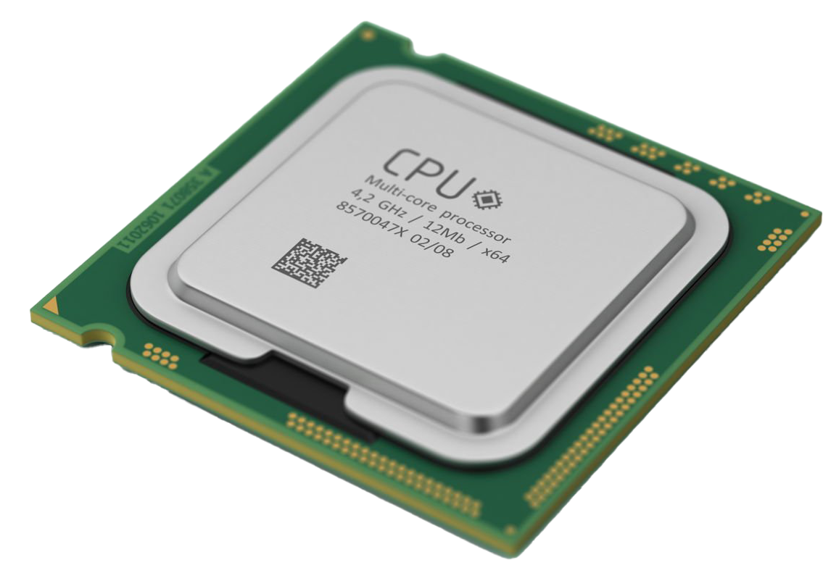

Slide 6
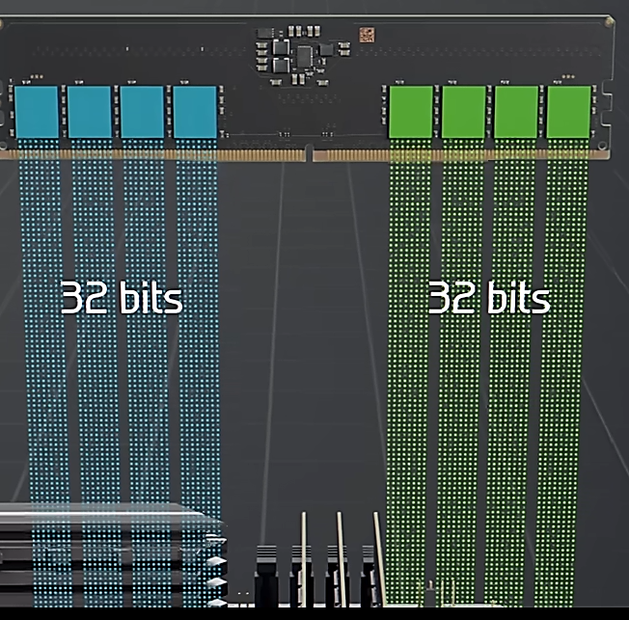
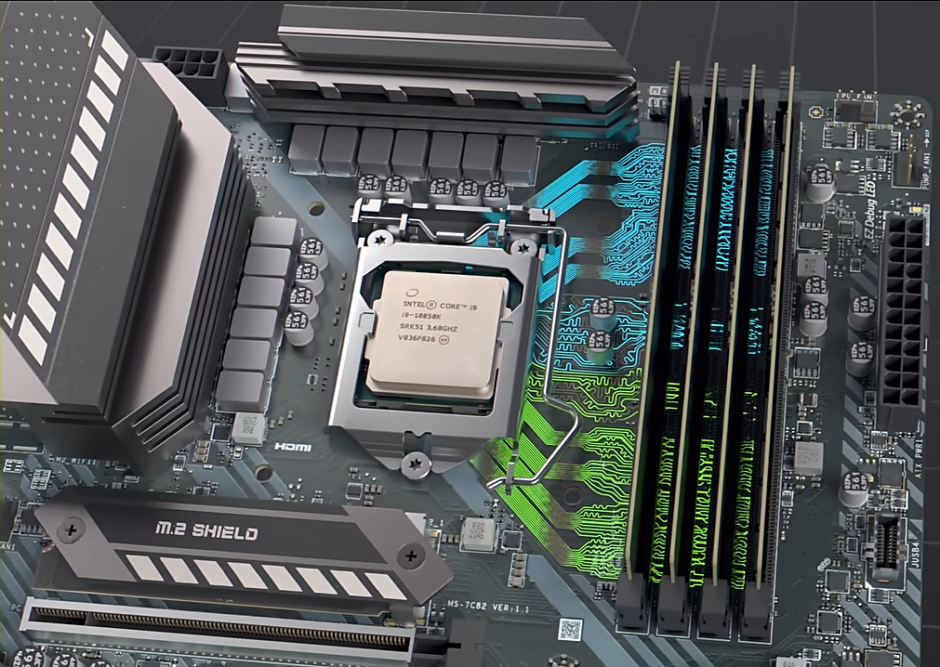
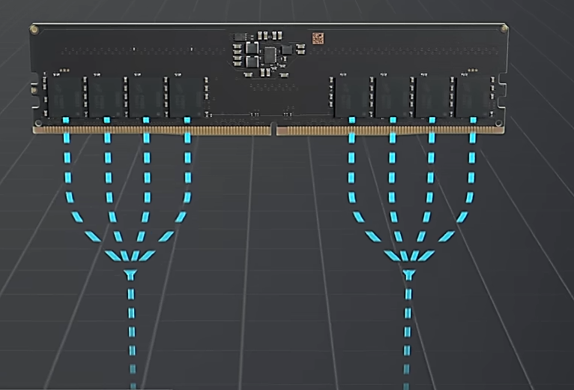
How do RAMs work?
Byte
Byte
Byte
Byte
Byte
Byte
Byte
Byte
Byte
11100111

Slide 7
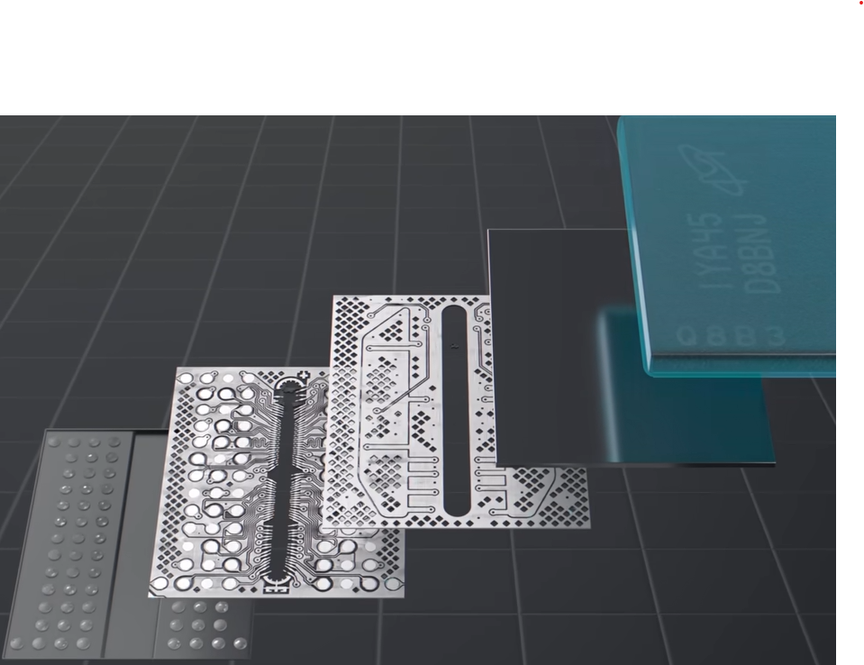
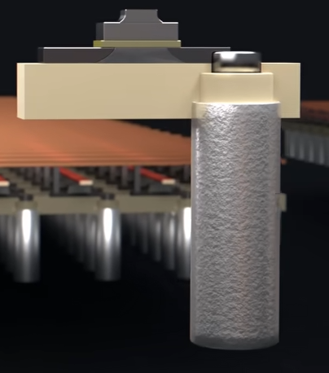
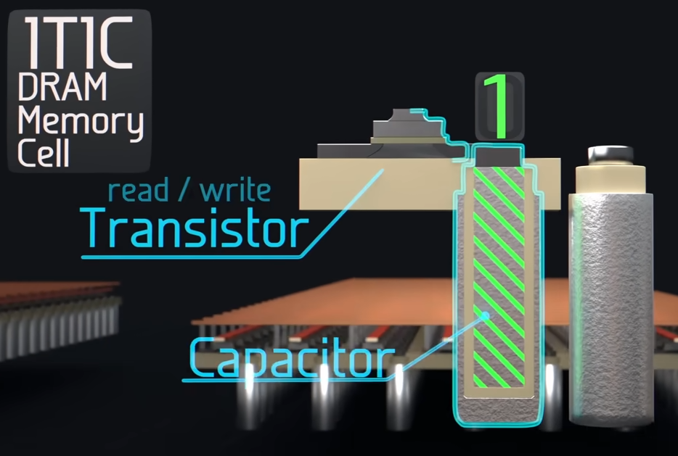

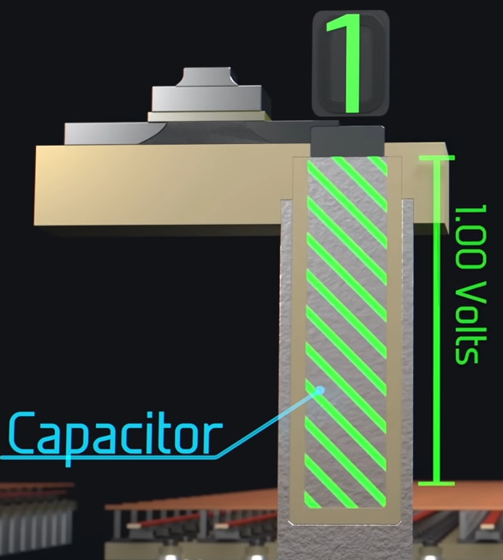
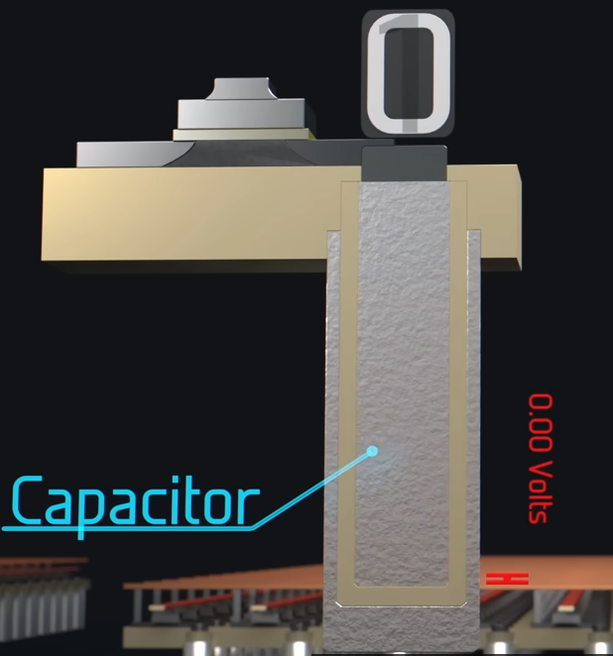
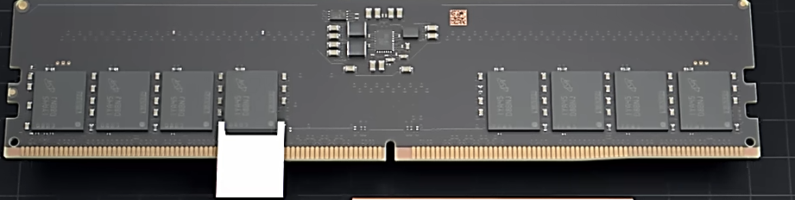

Slide 8
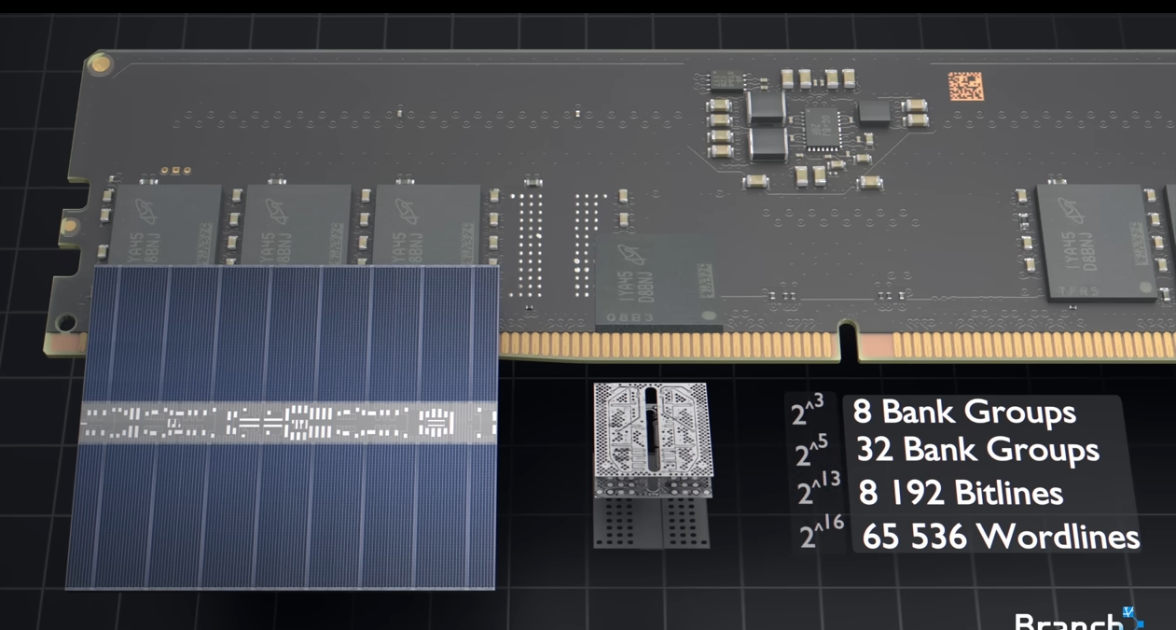
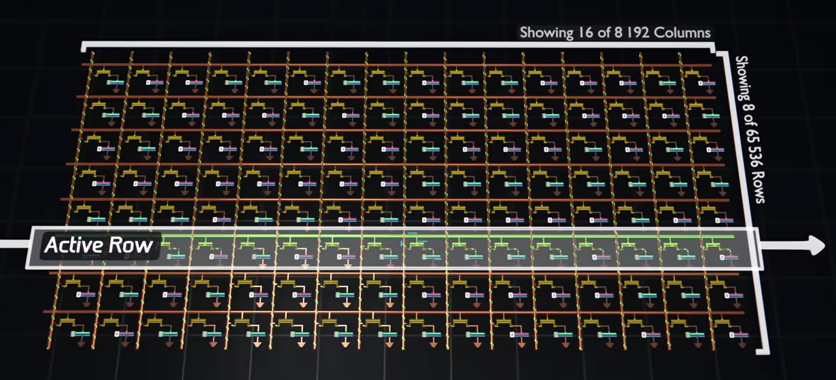
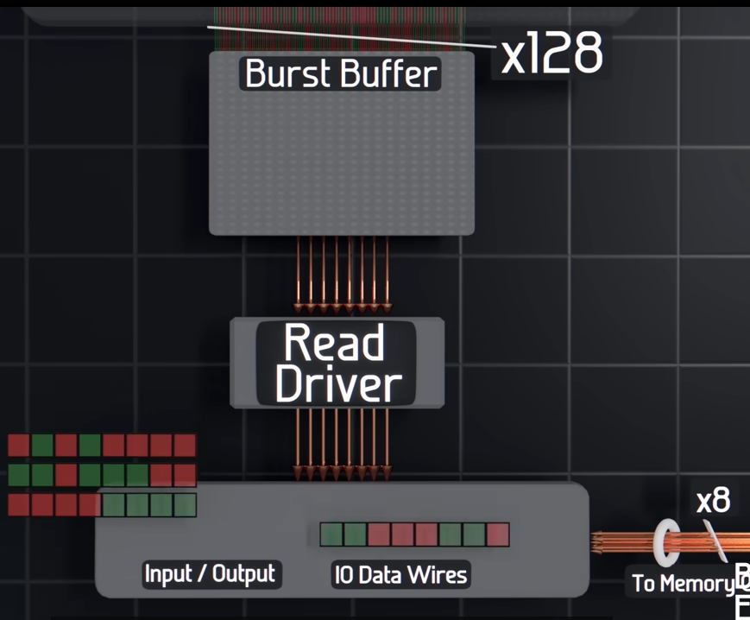
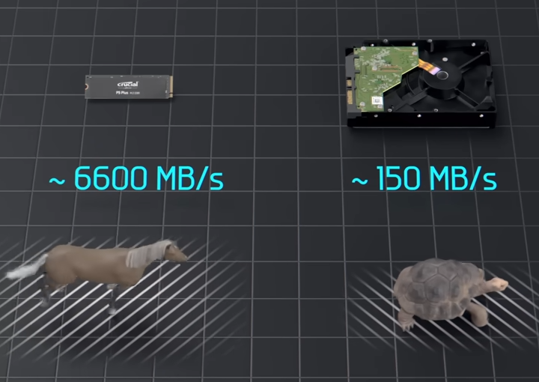

Slide 9
Type of RAM
RAM
SRAM
DRAM
DRAM : Dynamic RAM
Depend on Capacitor and transistor
SRAM : Static RAM
Depend on Switches

Slide 10
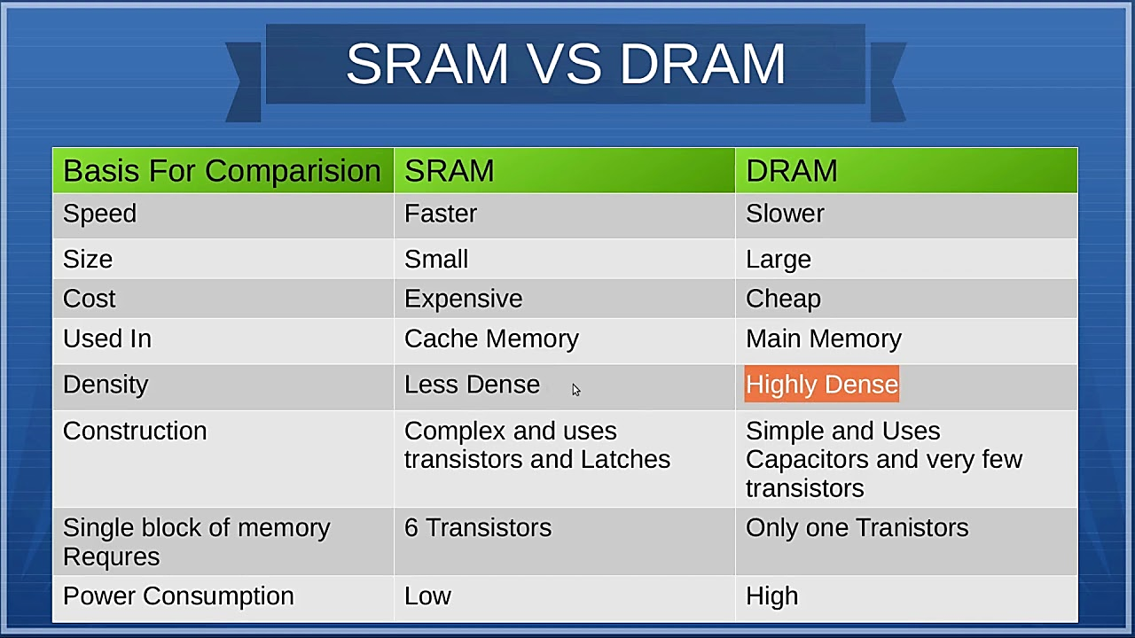

Slide 11
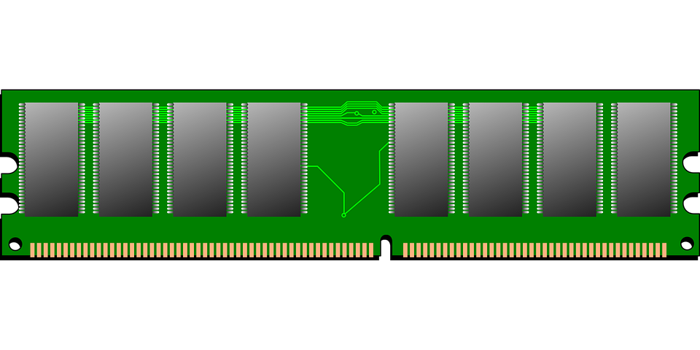
RAM
CPU
Data bus
Memory control
address bus
RAM speed is measured in Hz
Si
1333 MHZ = 1333 million Cyle per second
1333 MHZ = (1333 * 64) / 8 = 10664 MG per second
Data set = 64 bit

Slide 12

RAM Standard SDRAM => Synchronous Dynamic Random Access Memory
SDRAM (SDR SDRAM) 3.3V
Send one data set per Cyle
Send 64 bit per Cyle = 64 * Rotors
SI
SDRM 133MHZ = 64 * 133 * 1000000 = 8,512,000,000 bit / S

Slide 13
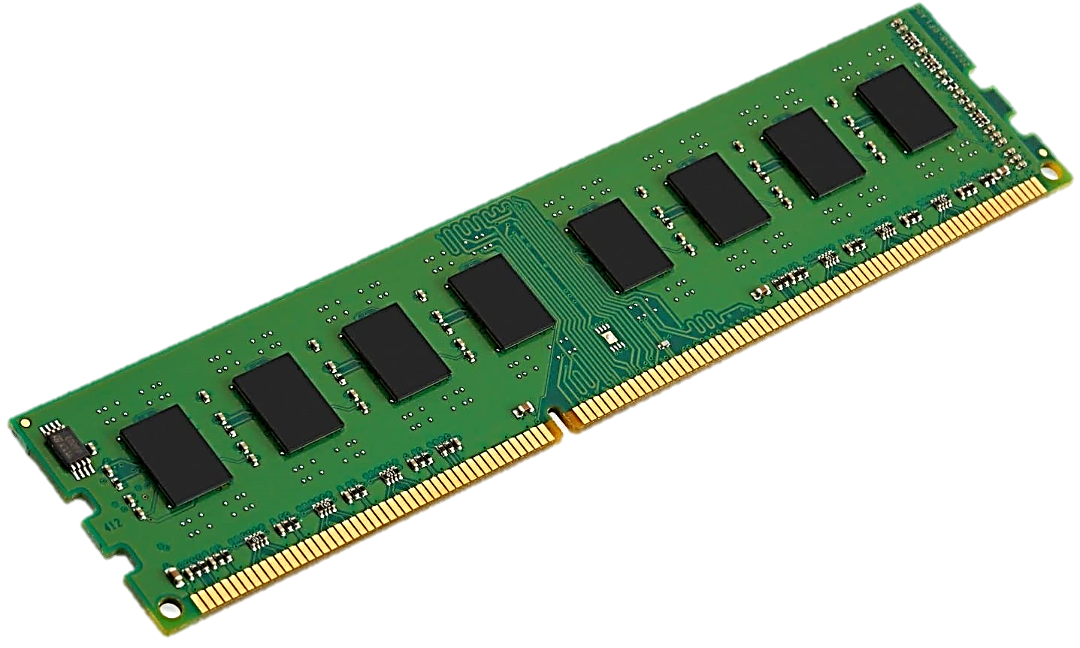
DDR (double data rate)
Send two data set per cycle
Speed: Ranges between 200 and 400 MHz
Bandwidth: From 1.6 to 3.2 Gbps.
Voltage: 2.5V (relatively high).
Pins: 184 pins.
Efficiency: Considered slow and power-hungry compared to modern technologies.

Slide 14
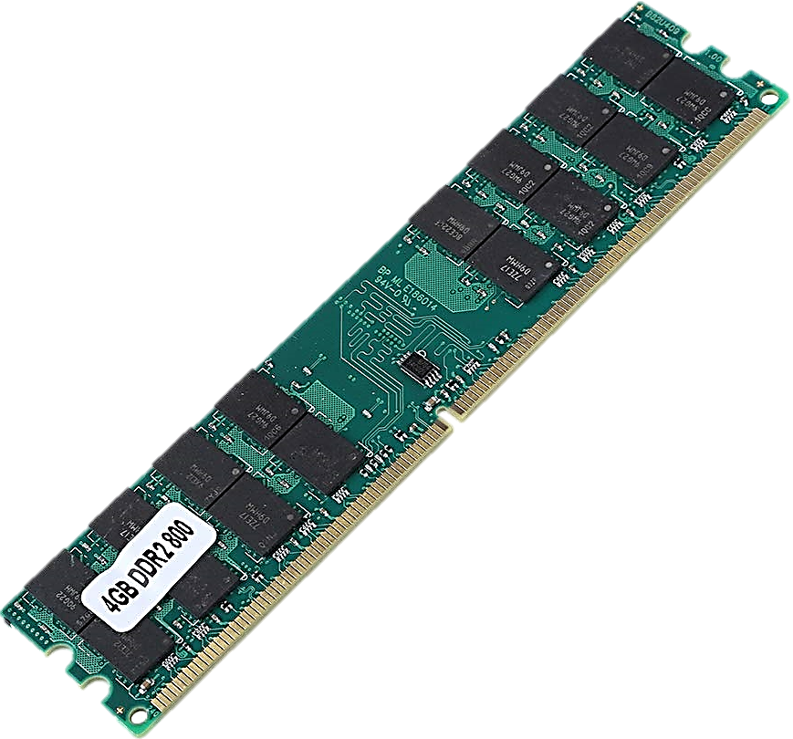
DDR2
send Four data set per cycle
Speed: Ranges between 400 and 1066 MHz
Bandwidth: From 3.2 to 8.5 Gbps.
Voltage: 1.8V (lower than DDR1).
Pins: 240 pins.
Efficiency: Faster than DDR1 and consumes less power, but less efficient compared to later generations.

Slide 15
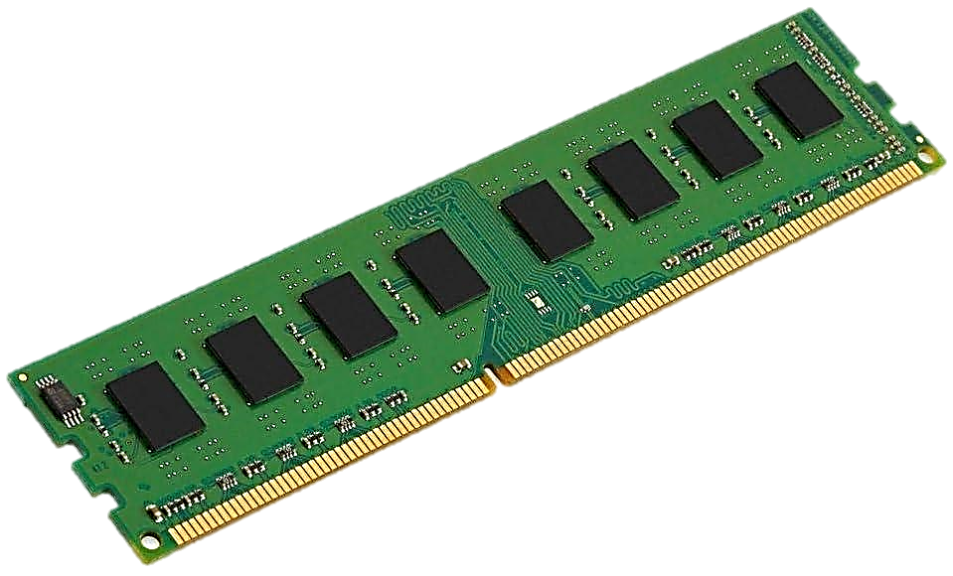
DDR3
send Eight data set per cycle
Speed: Ranges between 800 and 2133 MHz
Bandwidth: From 6.4 to 17 Gbps.
Voltage: Between 1.5 and 1.35V (available in low-power versions).
Pins: 240 pins.
Efficiency: Much more efficient than DDR2 in terms of speed and power consumption. It was common in computers from 2010 to 2015.

Slide 16
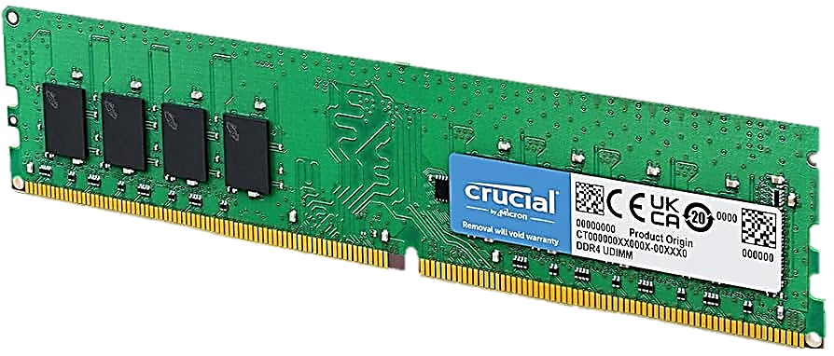
DDR4
send sixteen data set per cycle
Speed: Ranges between 1600 and 3200 MHz (and can go higher).
Bandwidth: From 12.8 to 25.6 Gbps.
Voltage: 1.2V (lower than DDR3).
Pins: 288 pins.
Efficiency: Offers significant improvements in speed and efficiency compared to DDR3, with lower power consumption. It’s widely used in modern computers.

Slide 17
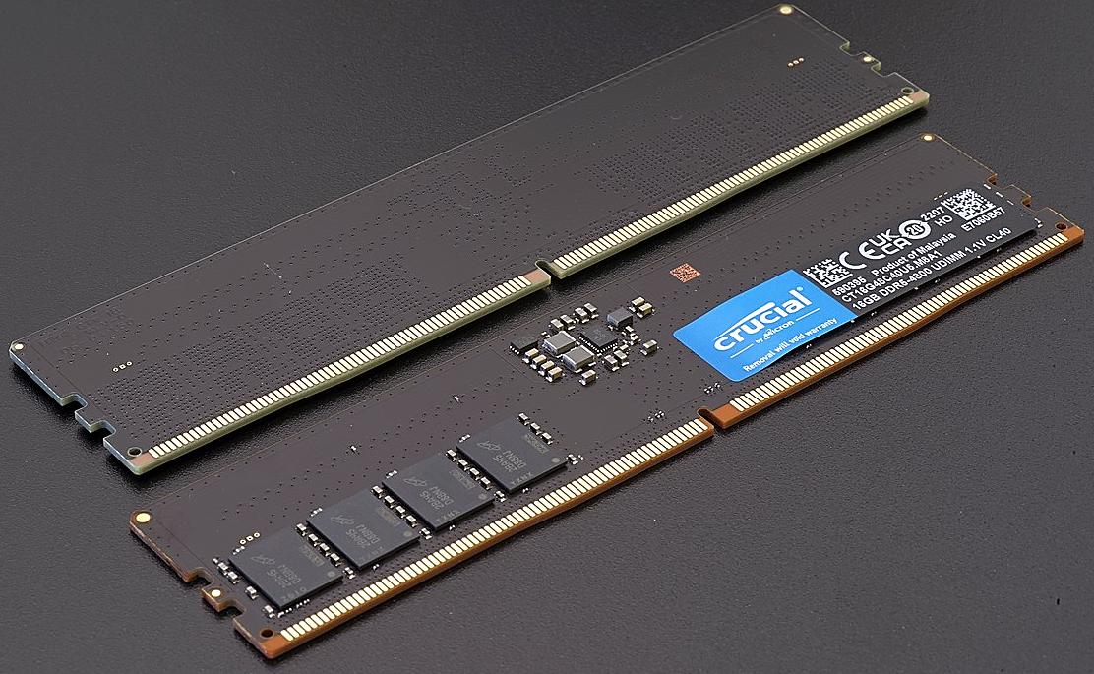
DDR5
Speed: Ranges between 3200 and 8400 MHz
Bandwidth: From 32 to 67.2 Gbps.
Voltage: 1.1V (lower than DDR4).
Pins: 288 pins.
Efficiency: Delivers exceptional performance compared to DDR4 in terms of speed and bandwidth, with even lower power consumption. It has recently entered the market and is considered the next generation of RAM.

Slide 18
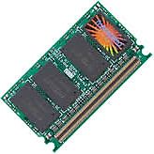
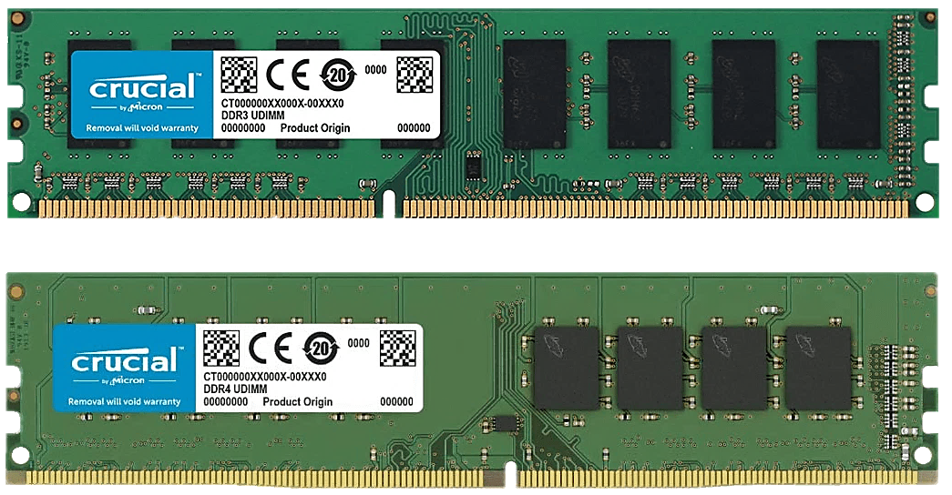
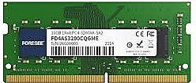
RAM modules type
DIMM (Dual Inline Memory Module)
SO-DIMM (Small Outline DIMM)
Micro DIMMs are used on subnotebook computers and are smaller than SO DIMMs
SIMM (single inline memory module)

Slide 19

Tank you

